Slide 1

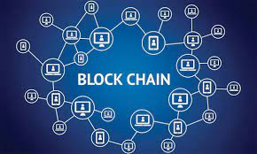
KLS's Gogte Institute of Technology
Department of Computer Science & Engineering
Course Name: Block Chain Management
Course Code: 18CS743
Unit III : Techniques For Trust and Integrity
Assistant Professor,
Ravi U. Kalkundri

Slide 2
Techniques for trust and integrity

Slide 3
3.1 Essentials of trust and integrity
3.1.1 Trust
Trust means different things in different contexts.
Trust is an essential criterion for the success of any system.
DEFINITION: Trust is a measure of confidence in the credibility of a peer participant in a system. Trust in a blockchain-based system is established by verification and validation of relevant participant data and transactions, and by immutable recording of appropriate information done with the consensus of the stakeholders.

Slide 4
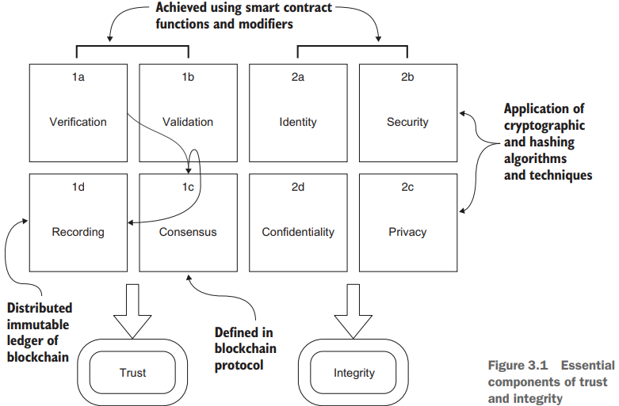
3.1 Essentials of trust and integrity
3.1.1 Trust
Figure 3.1, we can identify the various components of trust and integrity before we explore the concepts further.

Slide 5
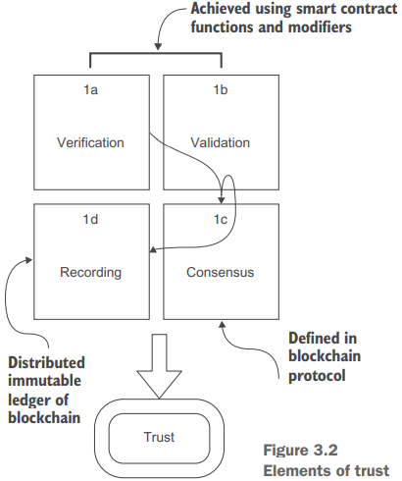
3.1 Essentials of trust and integrity
3.1.1 Trust
You establish trust by verification and validation; this aspect is shown in figure 3.2 as fundamental elements of trust (1a and 1b).

Slide 6
3.1 Essentials of trust and integrity
3.1.1 Trust
To understand the difference between verification and validation, let’s consider these real-world examples:
Verification (1a) is similar to a Transportation Security Administration (TSA) agent checking your identification at an airport security checkpoint. Verification is about general rules.
Validation (1b) is similar to an airline's gate agent making sure that you have a valid boarding pass. Validation is about application specific rules.
The recording (1d) is similar to TSA’s and the airline’s centralized database updated with the traveler’s status. In the case of blockchain, the differences are that recording is on a distributed immutable ledger and the use of consensus protocol (1c).
The bottom two cells (1c and 1d) of the trust quad chart in figure 3.2, consensus and immutable distributed recording, are the responsibility of the blockchain protocol.

Slide 7
3.1 Essentials of trust and integrity
3.1.2 Integrity
Integrity is about the truthfulness of the participants, the messages they send, the data, and the operations of the system under consideration.
DEFINITION Integrity, in the context of blockchain, means ensuring the security and privacy of data and confidentiality of transactions.

Slide 8
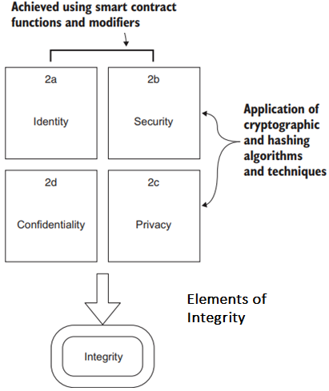
3.1 Essentials of trust and integrity
3.1.2 Integrity
Integrity, shown in the second quad of figure 3.1, begins with a method for uniquely identifying the peer participant on the node.
In a decentralized system, no username and password identify who you are, as in a centralized system. Blockchain account address is a simple way to specify a unique identity for a participant.
The elements of integrity—identity, security, privacy, and confidentiality (figure 3.1, 2a to 2d)—are based predominantly on the private-public key pair concept.

Slide 9
3.2 Digital democracy problem
Digital democracy encompasses many things, from simple digital identity cards in India to e-residency in Estonia.
We are concerned with systems that enable democracy by using digitization, such as internet-based communication and information systems—in particular, using internet-based electronic voting systems instead of paper ballots or mechanical machines.
PROBLEM STATEMENT
Consider an online ballot application. People vote to choose a proposal from a set of proposals. A chairperson registers the people who can vote, and only registered voters can vote (only once) on a proposal of their choice. The chairperson’s vote is weighted twice (x2) as heavily as regular people’s votes. The ballot process goes through four states (Init, Regs, Vote, Done), and the respective operations (initialize, register, vote, count votes) can be performed only in the corresponding states.

Slide 10
3.2 Digital democracy problem
3.2.1 Designing a solution
We’ll apply the design principles you learned in chapter 2
DESIGN PRINCIPLE 1 Design before you code, develop, and deploy a smart contract on a test chain, and thoroughly test it before you deploy it on a production blockchain, because when the smart contract is deployed, it is immutable.
DESIGN PRINCIPLE 2 Define the users of and use cases for the system. Users are entities that generate the actions and the input and receive the output from the system you’ll be designing.
DESIGN PRINCIPLE 3 Define the data assets, peer participants and their roles, rules to be enforced, and transactions to be recorded for the system you’ll be designing.

Slide 11
3.2 Digital democracy problem
3.2.1 Designing a solution
Here are the recommended steps for solving the ballot problem:
Apply design principles 1, 2, and 3 to design the use case diagram; use that diagram to discover the users, data assets, and transactions.
Use design principle 4, design the contract diagram that defines the data, modifiers, or rules for verification and validation, and functions.
Using the contract diagram, develop the smart contract in Solidity.
Compile and deploy the smart contract in the Remix IDE, and test it.

Slide 12
3.2 Digital democracy problem
3.2.2 Use case diagram
Here are the recommended steps for solving the ballot problem:
Let’s analyze the ballot problem using the UML diagram use case diagram. This diagram is the starting point for achieving the design principles of identifying the users, assets, and transactions.
The use case diagram is shown in figure 3.3.
The main actors and roles are as follows:
The chairperson can register voters and also self-register and vote.
Voters can vote.
Anybody can request the winner or results of the ballot process.

Slide 13
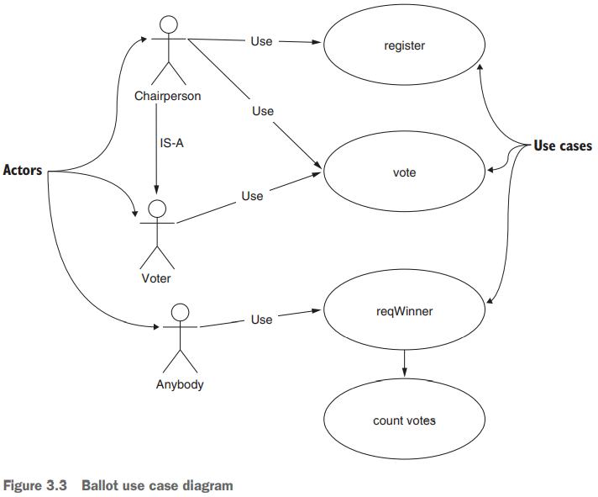
3.2 Digital democracy problem
3.2.2 Use case diagram
The use case diagram is shown in figure 3.3.

Slide 14
3.2 Digital democracy problem
3.2.3 Incremental development of code
The code for the balloting problem will be developed in four incremental steps so that you can to learn the smart contract development process.
Also, this process will allow you to learn Solidity language features by example. The four incremental steps in the development are as follows:
BallotV1—Define the data structures for the smart contract, and test them.
BallotV2—Add the constructor and the function to change the state of voting.
BallotV3—Add the other functions of the smart contract and a modifier to illustrate the use of Solidity features for enabling trust.
BallotV4—Add the trust elements require(), revert(), and assert(), and the function access modifier.

Slide 15
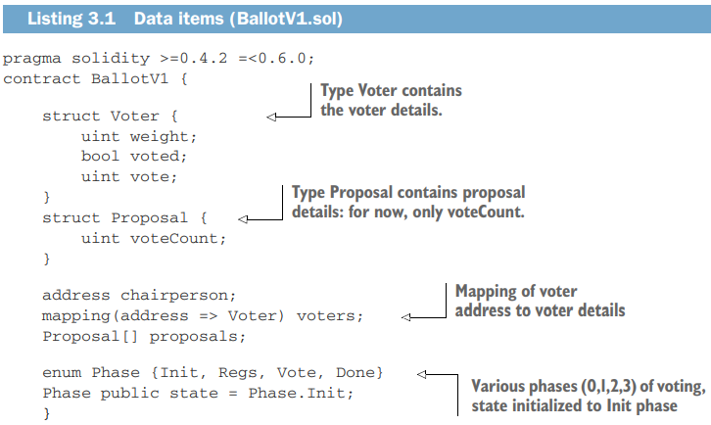
3.2 Digital democracy problem
3.2.4 Users, assets, and transactions
Let’s use this analysis as a guideline and code the two data items identified: voters and proposals, as shown in listing 3.1.
The phases of the voting specified in the problem statement are also coded into an enum or enumerated data type.
A Voter type and Proposal type are defined using the struct construct, and a special voter, chairperson, is also defined.
A mapping data structure maps the voter account address to the voter details, and an array defines the proposals (numbers) that are being voted on.

Slide 16
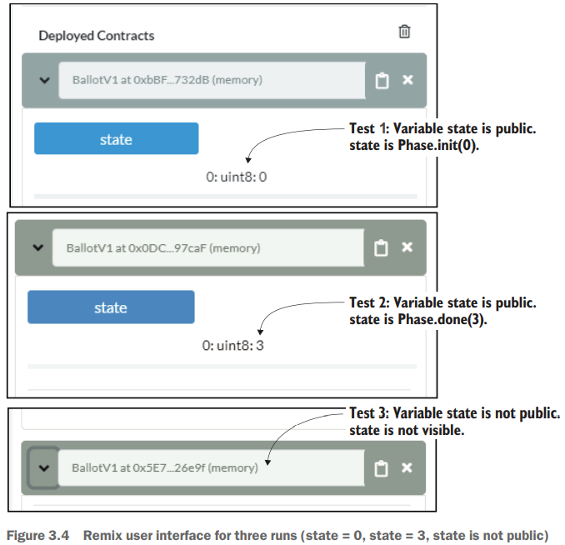
3.2 Digital democracy problem
3.2.4 Users, assets, and transactions

Slide 17
3.2 Digital democracy problem
3.2.5 Finite state machine diagram
Drawbacks of Use Case Diagram
Provides only static details;
Has no way to depict the dynamic timing and state transitions that the ballot process requires.
Diagram doesn’t impose the order in which the operations should occur: registration period, voting period, and the determination of the winner.
DESIGN PRINCIPLE 5 Use a finite state machine UML diagram to represent system dynamics such as state transitions within a smart contract.

Slide 18
3.2 Digital democracy problem
3.2.5 Finite state machine diagram
DESIGN PRINCIPLE 1 Design before you code, develop, and deploy on a test chain, and test before you deploy on a production blockchain, because once the smart contract is deployed it is immutable.
DESIGN PRINCIPLE 2 Define the users of and use cases for the system. Users are entities that generate the actions and input and receive the output from the system you’ll be designing.
DESIGN PRINCIPLE 3 Define the digital assets, peer participants and their roles, rules to be enforced, and transactions to be recorded for the system you’ll be designing.
DESIGN PRINCIPLE 4 Define a contract diagram that specifies the name, digital assets, functions, and rules for execution of functions and access of data.
DESIGN PRINCIPLE 5 Use a finite state machine UML diagram to represent system dynamics such as state transitions within a smart contract.
DESIGN PRINCIPLE 6 Implement the verification and validation needed for trust intermediation by using modifiers specifying the rules and conditions in a smart contract.

Slide 19
3.2 Digital democracy problem
3.2.5 Finite state machine diagram
In a voting process, voters are registered first, and there usually are deadlines for registration and voting.
In some U.S. states, you have to be registered 30 days before the election day, and the voting takes place and is completed in a single day for in-person voters.
If that is the case
Registration has to be completed before voting and before a specific deadline.
The functions for the ballot process proceed in a certain sequence.
Voting is open only for a specified period.
The winner can be determined only after the voting.

Slide 20
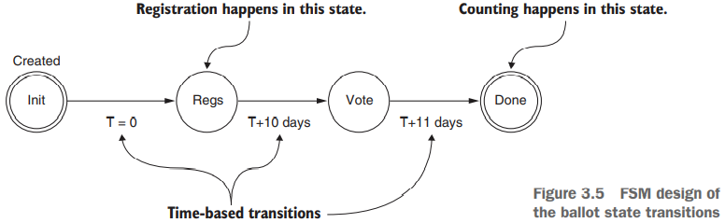
3.2 Digital democracy problem
3.2.5 Finite state machine diagram
Let’s apply this design principle and capture the dynamics with a state diagram, as shown in figure 3.5. This FSM is composed of
States, including a starting state and one or more ending states, indicated by double circles by convention
Transitions that take you from one state to another
Inputs that bring about the transitions (T=0, T+10 days, T+11 days)
Zero or more outputs during transitions. Registration (Regs), voting (Vote), and counting (Done).

Slide 21
3.2 Digital democracy problem
3.2.6 Trust intermediation
Typically, verification, validation, and exceptions in problems are specified by rules to be enforced and conditions to be checked.
Additionally, in a blockchain-based application, you should revert or abort any transactions that violate trust (represented by a rule) to prevent bad or unauthorized transactions from becoming part of the immutable ledger of the blockchain.

Slide 22
3.2 Digital democracy problem
3.2.7 Defining and using modifiers
Definition Modifiers are a language feature that supports explicit specification of rules for validation and verification. These are the gatekeepers that do the verification and validation, and thus are specifically meant for realizing trust.
Solidity provides various language features and functions that address these trust requirements.

Slide 23
3.2 Digital democracy problem
3.2.7 Defining and using modifiers
These language features are as follows:
Modifiers specify access control rules to verify and manage who has control of data and functions to establish trust and privacy. These modifiers are also called access modifiers to distinguish them from the visibility modifiers (public and private) of functions and data.
The require(condition) declaration validates the condition passed as a parameter and reverts the transaction if the check fails.
The revert() statement allows you to revert a transaction and also prevent it from being recorded on the blockchain.
The assert(condition) declaration validates the condition of the variable or data during the execution of a function and reverts the transaction if the check fails.

Slide 24
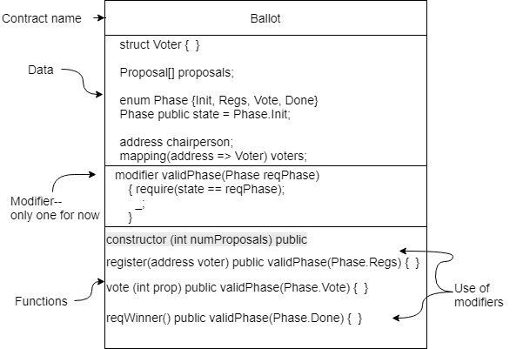
3.2 Digital democracy problem
3.2.7 Defining and using modifiers
Contract diagram with modifiers

Slide 25
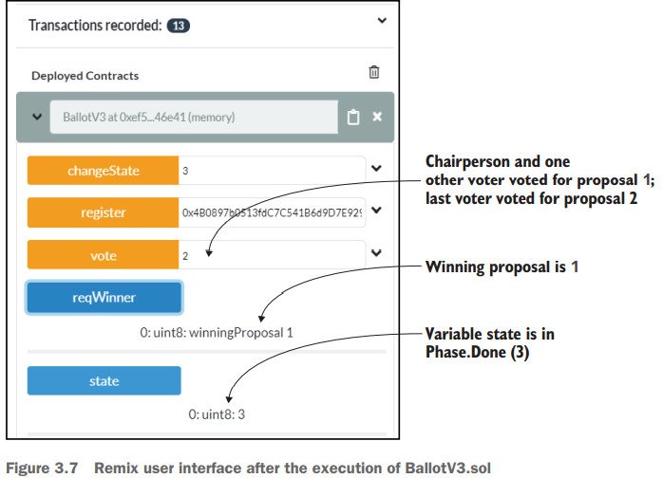
3.3 Testing
Testing of smart contracts is a crucial step in the Dapp design process.
Figure 3.7 shows a screenshot taken during the testing of the Ballot smart contract.

Slide 26
3.3 Testing
A robust testing process includes two different types of testing:
Positive tests—When given a valid set of data inputs, make sure that the smart contract performs correctly and as expected
Negative tests—When given invalid data inputs, make sure that the smart contract catches errors during verification and validation and that functions revert.

Slide 27
3.3 Testing
3.3.1 Positive tests
A robust testing process includes two different types of testing:
Let’s begin testing with the positive tests. In the Remix IDE, follow these steps:
Register three more voters (recall that the constructor already registers the chairperson). Copy and paste the second account number from the Account drop-down box (0x147 . . .) into the register() function’s parameter box. You can copy it from your notepad or use the little copy button to the right of where the account number is displayed in the IDE. Make sure that the chairperson’s account (0xca3 . . .) is selected in the Account box, and click the register button in the user interface. (Recall that only the chairperson can register voters.)
Repeat step 1 for two more voter accounts.
Use the stateChange() function to change the state to 2 or Phase.Vote. (Make sure that the chairperson’s account is selected in the Account box before you click the stateChange button.) Click the state button representing the public variable state. If you see the number 2, you are ready to vote.

Slide 28
3.3 Testing
3.3.1 Positive tests
With the chairperson’s account selected in the Account box, enter 2 in the vote() function’s parameter box—that is, the chair is voting for proposal number 2—and click the vote button.
In the Account box, select the second account that was registered in step 1 of this test sequence. Enter 1 for the proposal number in the vote() function’s parameter box, and click the vote button.
Repeat step 5 for the other two voter account numbers. Now you are set to test the results.
Change the state (from the chairperson’s account) by using the stateChange() function with parameter 3. state should now be Phase.Done, or 3. Now you can call the reqWinner() function that does the counting. Click the reqWinner button, and the winner should show up as proposal number 1.

Slide 29
3.3 Testing
3.3.2 Negative tests
These tests might be an exhaustive list of tests covering every possible scenario or a minimal set of tests covering only the most likely conditions.
Three representative negative test scenarios and the steps for executing them in the Remix IDE are given here:
Account other than chairperson registers a voter. This transaction should be rejected in the register() function’s regular code validation.
The smart contract is in the state Phase.Done, and an account tries to vote. The modifier validPhase should reject this transaction.
An account tries to vote for a proposal number that doesn’t exist. This transaction is rejected by the condition in the vote() function

Slide 30
3.4 Using modifiers, require(), and revert()
You’ve learned how to define a rule by using the modifier feature in Solidity.
What if you have more than one rule for executing a function?
You can apply a series of rules (access modifiers) to a function invocation.
What if a condition is to be checked during or after the execution of the statements within a function?

Slide 31
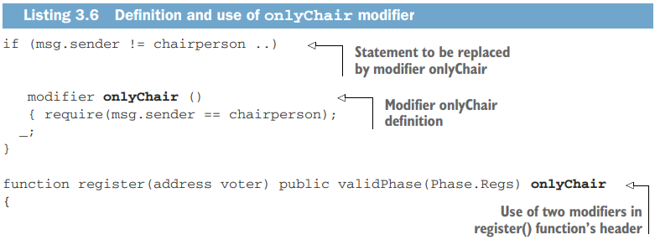
3.4 Using modifiers, require(), and revert()
In this case, you can use a require() clause that reverts the function if the condition specified within it fails.
The modifier validPhase specified in the Ballot smart contract uses a require() clause for checking the condition inside it and, if it fails, reverts the transaction.
In the Ballot example, a single modifier was used in the function headers to validate the system parameters.
Recall that the validPhase modifier enforces that all three functions—vote(), register(), and reqWinner()—are in the correct phase when they are invoked.

Slide 32
3.4 Using modifiers, require(), and revert()
You apply multiple modifiers to a function by specifying them in a whitespace-separated list.
Modifiers are evaluated in the order in which they’re presented, so if the outcome of one modifier depends on that of another, make sure that you order the modifiers in the right sequence.
In Ballotv3.sol, which uses the access modifiers validPhase and onlyChair, the validPhase modifier may take precedence and be applied first.
In other words, if the phase is incorrect, you don’t have to check who is invoking the register() function.
The header of the register() function, therefore, becomes
Function register(address voter) public validPhase(Phase.Regs) onlyChair

Slide 33
3.5 Assert() declarations
assert(), which asserts that a condition is met during the computation process inside a function
Suppose that you would like at least three votes (or majority votes) to be cast for the winning proposal in the ballot problem we’ve been discussing.
You can enforce this rule by using an assert() clause at the end of the reqWinner() function.
You can validate the parameters not only on entry to a smart contract function, but also at various stages of computation inside a function.
Using assert(winningVoteCount>=3) will cause the function to revert if a vote count of 1 or 2 is the highest or number of voters is less than 3.

Slide 34
3.5 Assert() declarations
assert(), which asserts that a condition is met during the computation process inside a function
Listing 3.7 shows the Ballot smart contract code with these incremental improvements: another modifier, onlyChair, and the assert() function.
The combination of revert(), require(), and assert() along with modifiers and their proper use will help you address exceptions through verification and validation, resulting in robust trust intermediation by the smart contracts. require() used instead of an if statement means that a transaction will be reverted if a condition fails.
If the function call reverts, no Tx is recorded on the blockchain for this function call. It is critical to understand that revert() stops the Tx from happening

Slide 35
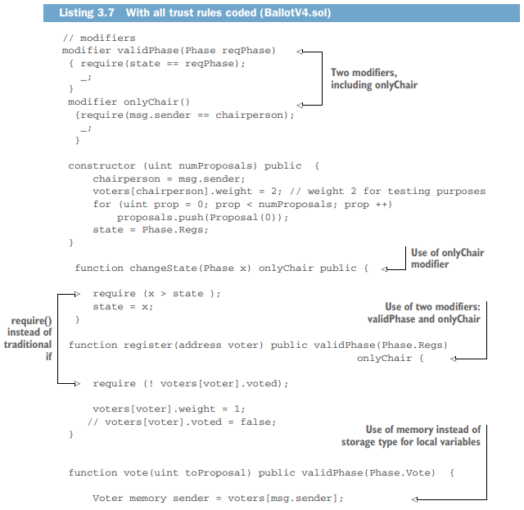
3.5 Assert() declarations

Slide 36
3.5 Assert() declarations
Functions assert() and require() are similar in that both check conditions and revert the transaction if the check fails.
You use require() for common validations such as checking the limits of a variable’s value (such as age >= 18).
You expect require() to fail sometimes; that is reasonable. assert() is meant for handling exceptions.
You expect that this condition should not normally fail, for example, you might use assert(headcount == 44).
If a failure occurs in the middle of the night! On a serious note, an assert() failure costs a lot more in wasted blockchain gas (execution cost) than require() reverting, so be selective about what to use when.
Use assert() sparingly for managing exceptions.
Use require() for validation of data, computations, and parameter values.
The combination of revert(), require(), and assert() along with modifiers and their proper use will help you address exceptions through verification and validation, resulting in robust trust intermediation by the smart contracts. require() used instead of an if statement means that a transaction will be reverted if a condition fails.

Slide 37
From smart contracts to Dapps

Slide 38
4 Introduction
You designed and developed the core component of a blockchain application: the smart contract.
But the logic coded in a smart contract cannot act alone.
You need user-facing applications that will trigger the smart contract functions and blockchain services.
These applications invoke smart contract functions, which in turn verify, validate, and record the resulting transactions and data on the distributed ledger of the blockchain.
Here you’ll learn about the structure of this larger system, called a Decentralized Application (Dapp), explore the techniques and tools for developing Dapps.

Slide 39
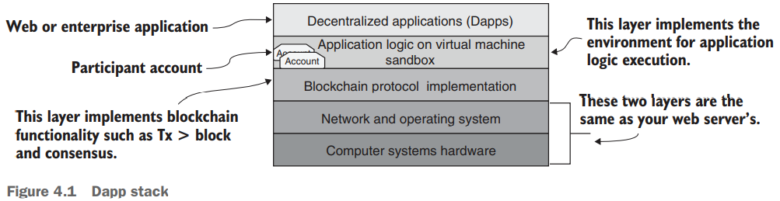
4 Introduction
Recall the Dapp stack and the definition of a Dapp from chapter 1, shown in figure 4.1.
DEFINITION Dapps are web or enterprise applications that contain decentralized smart contract logic to invoke blockchain functions.

Slide 40
4 Introduction
Figure 4.2 depicts two nodes connected by a blockchain network.
If you were to separate the second layer of the Dapp stack (figure 4.1) in these two nodes from its surrounding layers (as indicated by the dotted lines in figure 4.2) and take a peek, you’d see the APIs, ports, server code, and other scripts integrating the layers.
These components are the ones you will work on while developing a Dapp.

Slide 41
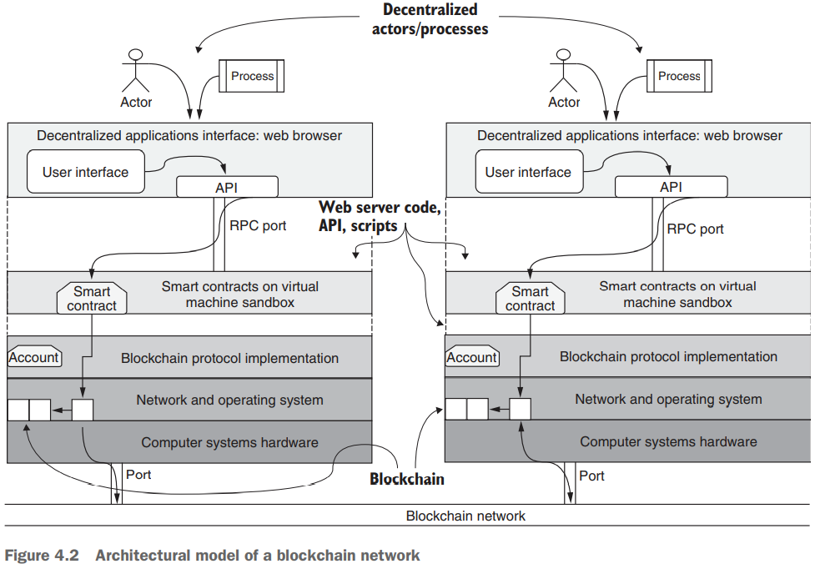
4 Introduction
Figure 4.2 depicts two nodes connected by a blockchain network.

Slide 42
4 Introduction
Starting at the top, the users (actors) or processes acting on behalf of users invoke the UI functions.
These functions use web application software and blockchain APIs to connect to smart contract functions.
Txs representing the smart contract function invocations are recorded on the blockchain.
You can follow the operational flow in a node from an actor to the consistent blockchain recording on both nodes via the blockchain network.
This figure also illustrates how a blockchain-based Dapp is not a standalone application but is dependent on its host operating system’s file system, ports, and network capabilities.

Slide 43
4 Introduction
To develop and program the top two layers of the Dapp stack of a blockchain network, we must keep in mind that blockchain programming is complex and that the Dapp stack is different from a traditional web stack.
Following are some of the artifacts and techniques that you’ll use for Dapp development:
For every Dapp project, a -app module for the web application and a -contract module for smart contracts
A web server and a package manager (Node.js and the Node Package Manager [npm])
A blockchain provider (such as Ganache) called web3 provider
A development tool, the Truffle suite (IDE) that provides an integrated environment to deploy and test a Dapp
Account management using the MetaMask browser plugin

Slide 44
4.1 Dapp development using Truffle
Truffle is an integrated development environment and testing framework that provides a suite of features and commands for end-to-end Ethereum-based Dapp development, including commands for
Initializing a template or base directory structure for a Dapp (truffle init)
Compiling and deploying smart contracts (truffle compile)
Launching a personal blockchain for testing with a console (truffle develop)
Running migration scripts for deploying smart contracts (truffle migrate)
Opening a command-line interface to Truffle for testing without the Dapp UI (truffle console)
Testing the deployed contract (truffle test)A web server and a package manager (Node.js and the Node Package Manager [npm])

Slide 45
4.1 Dapp development using Truffle
4.1.1 The development process
Here are the major steps in the development process:
Analyze the problem statement; design and represent the solution guided by design principles and UML diagrams.
Develop and test the smart contract, using the Remix web IDE.
Code the end-to-end Dapp, test and deploy it on test blockchains, and migrate it to main networks using the Truffle IDE.
Ready to launch a Dapp development project?

Slide 46
4.1 Dapp development using Truffle
4.1.2 Installing Truffle
Follow these steps to install the required software packages:
Install the operating system: For Linux, download and install Ubuntu Linux LTS. You can also use CentOS, Arch Linux, OpenSUSE, or other distributions. For Windows, make sure that you have a 64-bit machine with the Windows 10 operating system.
Install the browser. Download Chrome from https://www.google.com/chrome, and follow setup to complete the installation process. Google Chrome should start automatically when installation is complete.
Download and install Node.js and npm LTS from https://nodejs.org/en. You can also install these packages from the repositories by running the following commands in a terminal window.
Check the installation and versions (node v12.16.0 and npm 6.13.4 and later)
Install the Truffle suite (IDE) from its GitHub repository at https://github.com/ trufflesuite/truffle or via npm as follows, and verify that its version is 5.1.X or later: npm install -g truffleOperating system—Linux Ubuntu 18.04, macOS (Sierra or later), or Windows 10 (or later)

Slide 47
4.1 Dapp development using Truffle
4.1.3 Building the Dapp stack
The next steps focus on the upper levels of the Dapp stack (figure 4.3), and correspond to the following list of tasks (recall that this stack was introduced at a high level in chapter 1):
Install a local blockchain layer (section 4.2).
Develop a smart contract layer and deploy (section 4.3).
Develop the web application UI layer (section 4.4).
Configure the web server and develop glue code connecting the UI to the smart contract layer (section 4.4).
Initializing a template or base directory structure for a Dapp (truffle init)

Slide 48
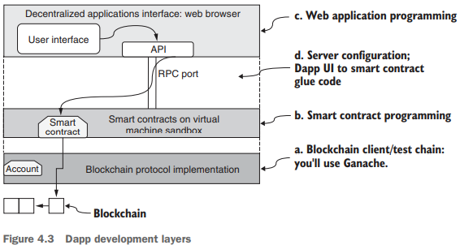
4.1 Dapp development using Truffle
4.1.3 Building the Dapp stack

Slide 49
4.2 Install Ganache test chain
For the blockchain layer, several options are available, from the simulated VM that you used in the Remix IDE to a full-blown Geth (Go Ethereum) client.
Download Ganache from https://www.trufflesuite.com/ganache, and install it by clicking the downloaded file and clicking the Quickstart button.
Ganache is also an Ethereum client, and by default, it is configured to run on the localhost.
Uses:
It’s ideal for testing your Dapp prototypes;
It provides ten accounts, each with 100 mock ether for paying for the gas points for execution as well as for transferring among accounts.

Slide 50
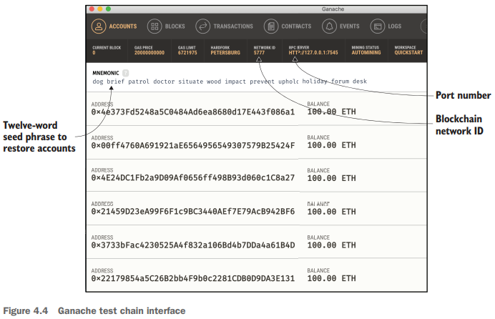
4.2 Install Ganache test chain
Its blockchain interface is shown in figure 4.4.
a set of seed words or mnemonics; copy and save them somewhere, because you’ll need them to authenticate access to the chain during testing of the Dapp.

Slide 51
4.3 Develop the smart contract
The problem statement is repeated here for your convenience.
PROBLEM STATEMENT
Consider an online ballot application. People vote to choose a proposal from a set of proposals. A chairperson registers the people who can vote, and only registered voters can vote (only once) on a proposal of their choice. The chairperson’s vote is weighted twice (x2) as heavily as regular people’s votes. The ballot process goes through four states (Init, Regs, Vote, Done), and the respective operations (initialize, register, vote, count votes) can be performed only in the corresponding states.
Voting phase transitions are usually dealt with outside the balloting process.
We’ll assume that an authority (such as an election commission) outside the chain manages the voting stages.

Slide 52
4.3 Develop the smart contract
4.3.1 Create a project folder
The first step is creating and initializing a standard directory structure to house your contracts.
Truffle provides a template directory with the required structure.
These items are the Ballot smart contract artifacts. Files and folders are as follows:
contracts/—Solidity source files for your smart contracts. An important contract called Migrations.sol is here; this smart contract has the script for facilitating the deployment of other smart contracts of a project.
migrations/—Truffle uses a migration system to handle smart contract deployments. Migration is an additional script (in JavaScript) that keeps track of changes in the contracts under development.
test/—JavaScript and Solidity tests for your smart contracts.
truffle-config.js—Truffle configuration file, containing, for example, configuration for the blockchain network ID, IP, and RPC port number.

Slide 53
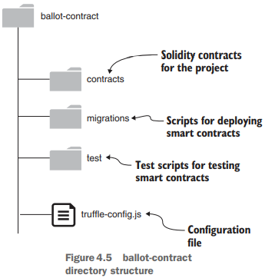
4.3 Develop the smart contract
4.3.1 Create a project folder
The directory structure initialized by the truffle init command is shown in figure 4.5.
You’ve got to be in the correct directory when executing Truffle commands; otherwise, the commands will result in an error.
You’ll use this directory structure as a guideline for Truffle-based development.

Slide 54
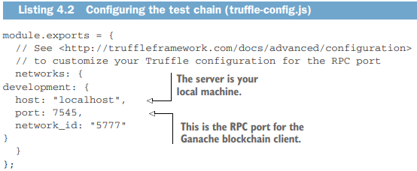
4.3 Develop the smart contract
4.3.2 Add smart contract and compile
Now it’s time to add the smart contract.
The Solidity contract in this case is Ballot.sol from listing 4.1. Run the following commands to navigate to the contracts directory.
4.3.3 Configure blockchain network
Now edit the truffle-config.js file in the ballot-contract directory so that it matches listing 4.2.
This file is the configuration file for the test blockchain you’ll deploy next,

Slide 55
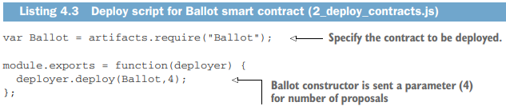
4.3 Develop the smart contract
4.3.4 Deploy the smart contract
The last step before you deploy is adding a file to the migrations directory to deploy your smart contract.
In this case, the smart contract is called Ballot, and to deploy it, you’ll add a migration script named 2_deploy_contracts.js to the migrations directory.
The file’s contents are shown in the next listing.
The name of the artifact should be the same as the smart contract name at the top—in this case, Ballot.

Slide 56
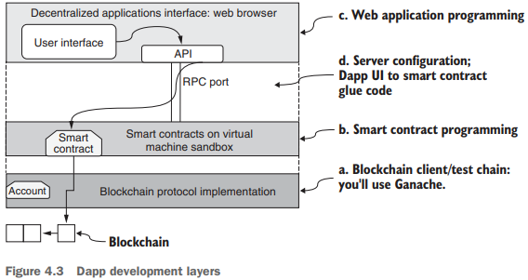
4.4 Develop and configure the web application
Blockchain infrastructure hosts the smart contract and the Ethereum VM (figure 4.3) on which the smart contract code is run.
A web application provides a convenient means for a user to interact with the smart contract.

Slide 57
4.4 Develop and configure the web application
To build the web client front end, you’ll need
HTML, JavaScript, and CSS for rendering the server contents for user interaction
A server to host the base entry script defined in index.js
Server code (app.js) linking the web server and web client
Additional wrappers and plugins for any frameworks such as Bootstrap and the web3 API
A package configuration file, package.json test/—JavaScript and Solidity tests for your smart contracts.

Slide 58
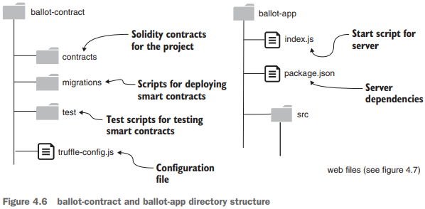
4.4 Develop and configure the web application
These items are organized in a standard project directory structure, as shown in figure 4.6.
On the left is the ballot-contract directory, and on the right, you see the contents of ballot-app.

Slide 59
4.4 Develop and configure the web application
4.4.1 Develop ballot-app
This structure is the standard directory format you’ll use for Dapp development.
The only other directory in the ballotapp is the src directory (figure 4.7), which contains
The usual artifacts for a web page (CSS, fonts, images, JavaScript).
The landing page for the web application (index.html).
proposals.json, which holds details about the proposals being voted on. (Images for the proposals are in the images subdirectory.)
app.js, the glue code connecting the web server layer and the smart contract layer.
You can review the files for the web app by unzipping src.zip in the codebase for this chapter and cloning it into the ballot-app folder

Slide 60
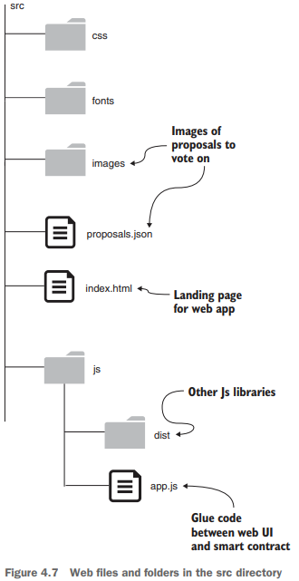
4.4 Develop and configure the web application
4.4.1 Develop ballot-app
The src directory contains the source for the web application part.
Communication from the web client to the blockchain server is through JSON over RPC.

Slide 61
4.4 Develop and configure the web application
4.4.2 Launch the ballot-app
At this point, you have assembled all the components for the Ballot-Dapp.
4.4.3 Install MetaMask wallet
You have one more step—installing MetaMask—to complete before you begin testing the Dapp.
Before you test :
The account addresses are needed to identify the decentralized participants.
Transactions have to be digitally signed and confirmed by the participant (sender of Txs).
The balance of the account has to be verified to ensure that it has sufficient ether (gas points) to pay for the cost of execution of functions.
You need a mechanism for accomplishing all these important operations.
For this purpose, you’ll use a convenient browser plugin called MetaMask

Slide 62
4.4 Develop and configure the web application
4.4.3 Install MetaMask wallet
MetaMask connects web clients to the web server and blockchain provider through the RPC port, as shown in figure 4.8.
Features of MetaMask:
described as a crypto wallet and a gateway to blockchain applications
an intelligent digital wallet
acts as a proxy between the web client and the blockchain server.
securely manages the accounts created on the blockchain and their balances in ether, and
digitally signs the transactions issued by the participant accounts.

Slide 63
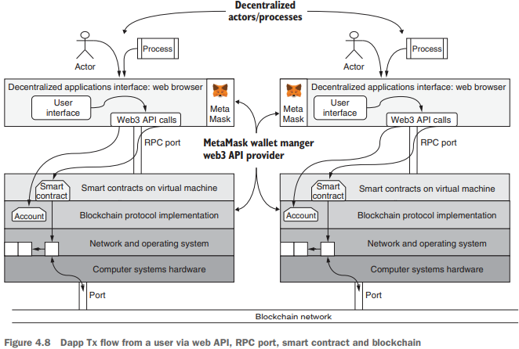
4.4 Develop and configure the web application
4.4.3 Install MetaMask wallet

Slide 64
4.4 Develop and configure the web application
4.4 Interact with Ballot-Dapp
Start a web browser, then click the MetaMask symbol in the top-right corner of the browser window a small window opens.
The points of interest in figure 4.10 are indicated by 4A–4F.
Make sure that you can locate these points on the web page and in the MetaMask window:
4A is the opening screen.
4B, 4C, and 4D are the Register, Vote, and Declare Winner buttons for contract functions.
4E is the MetaMask plugin’s drop-down screen.
4F is the account icon on MetaMask. described as a crypto wallet

Slide 65
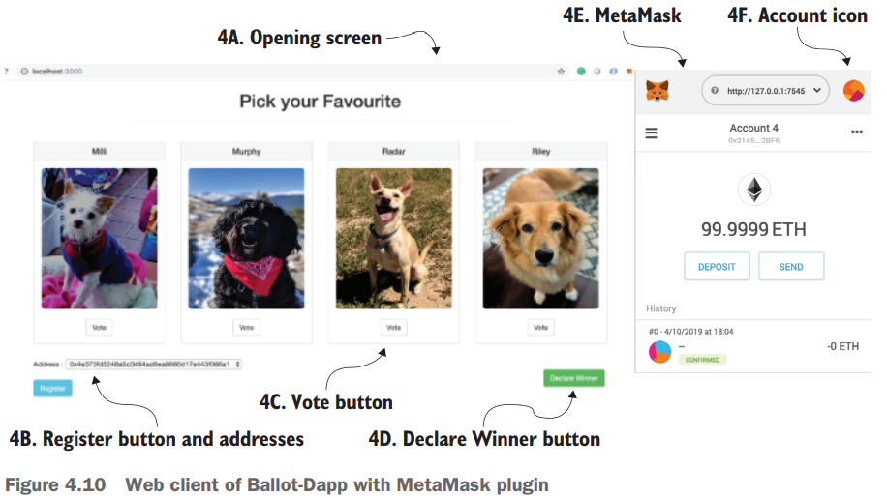
4.4 Develop and configure the web application
4.4 Interact with Ballot-Dapp
Figure 4.10 are indicated by 4A–4F.

Slide 66
4.4 Develop and configure the web application
4.4.5 Connect web client to smart contract
One more piece of code is important for Dapp development: the piece that connects the web app to the smart contract.
app.js is the glue that connects the web client to the smart contract through a set of handler functions.
This code provisions the web3 and smart contract services for the web front end to call and invoke.

Slide 67
Thank You

